Slide 1
What does
EGMMS BYOD
look like?

Slide 2
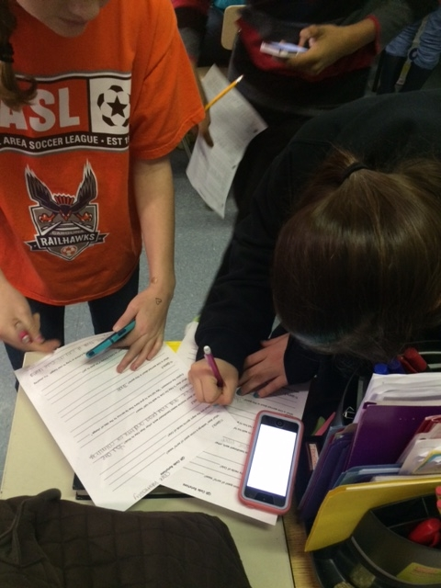
Collaboration
Students working together with information beyond the four walls.

Slide 3
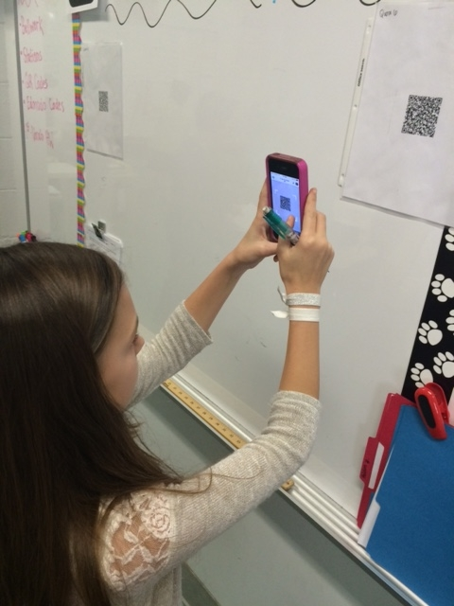
Discovery
Students gathering data in real time.

Slide 4
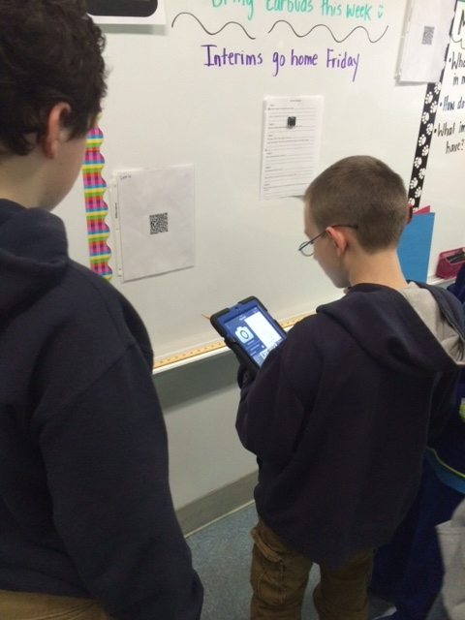
Engagement
Students using an authentic tool.

Slide 5
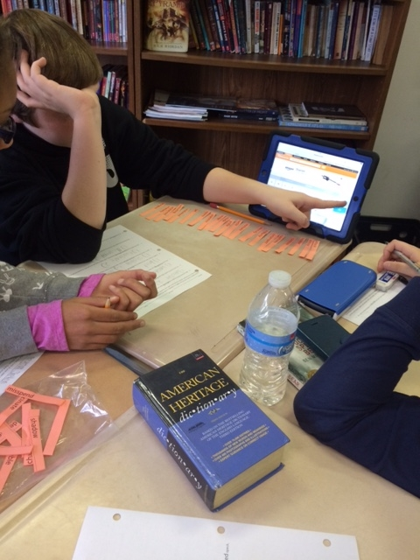
Resources
Students using more than one source.

Slide 6
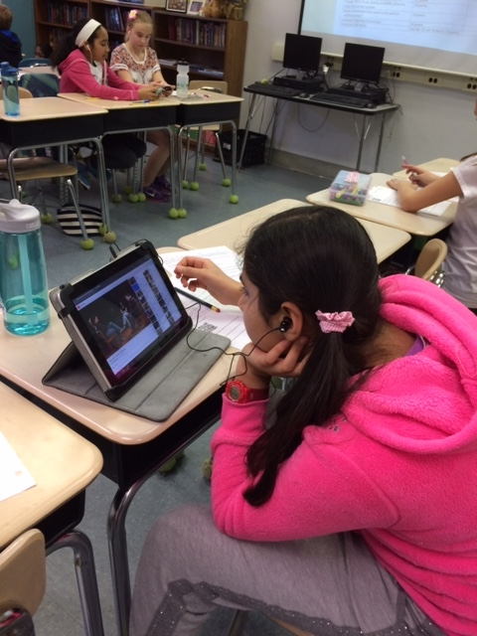
Digital Media
Students experience various learning styles.

Slide 7
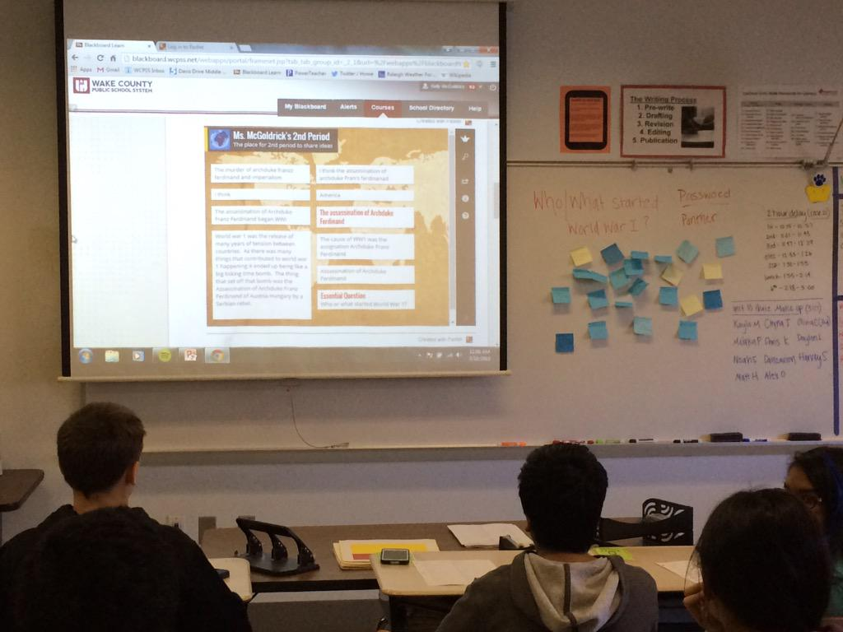
Formative Assessmentt
Students assess their own learning.

Slide 8
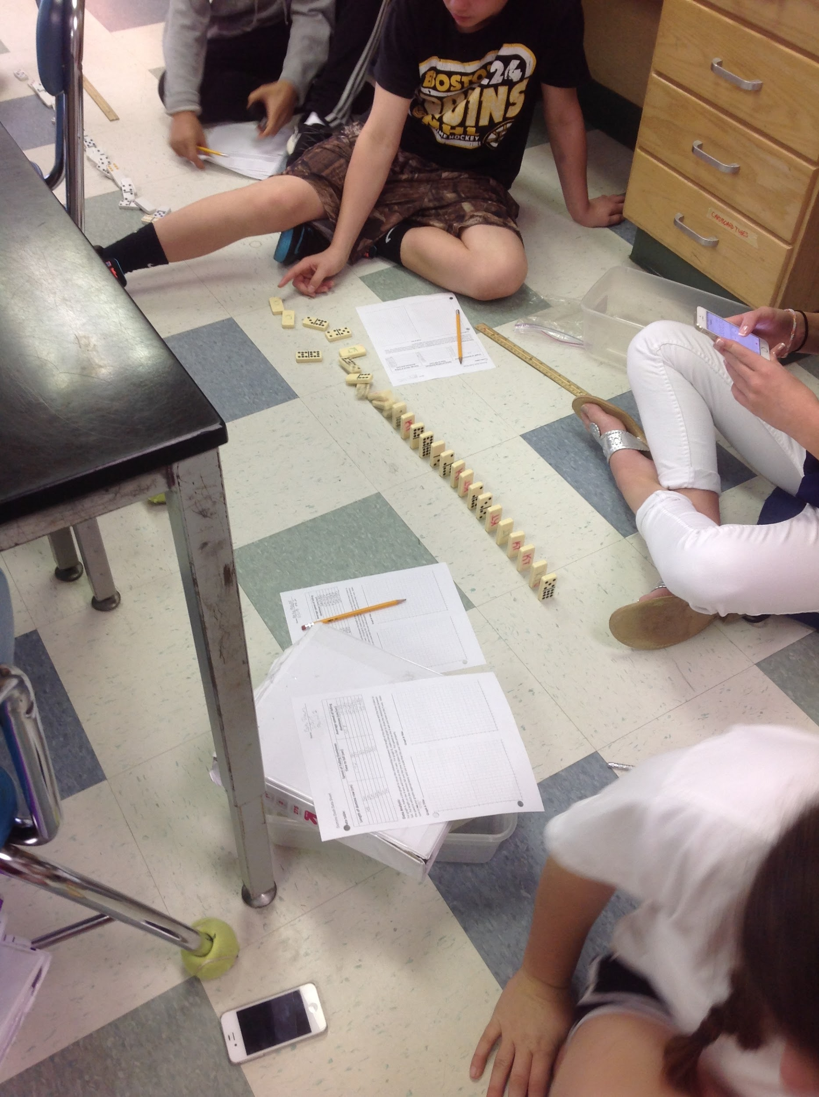
Data Collection
Students use devices to collect data.

Slide 9
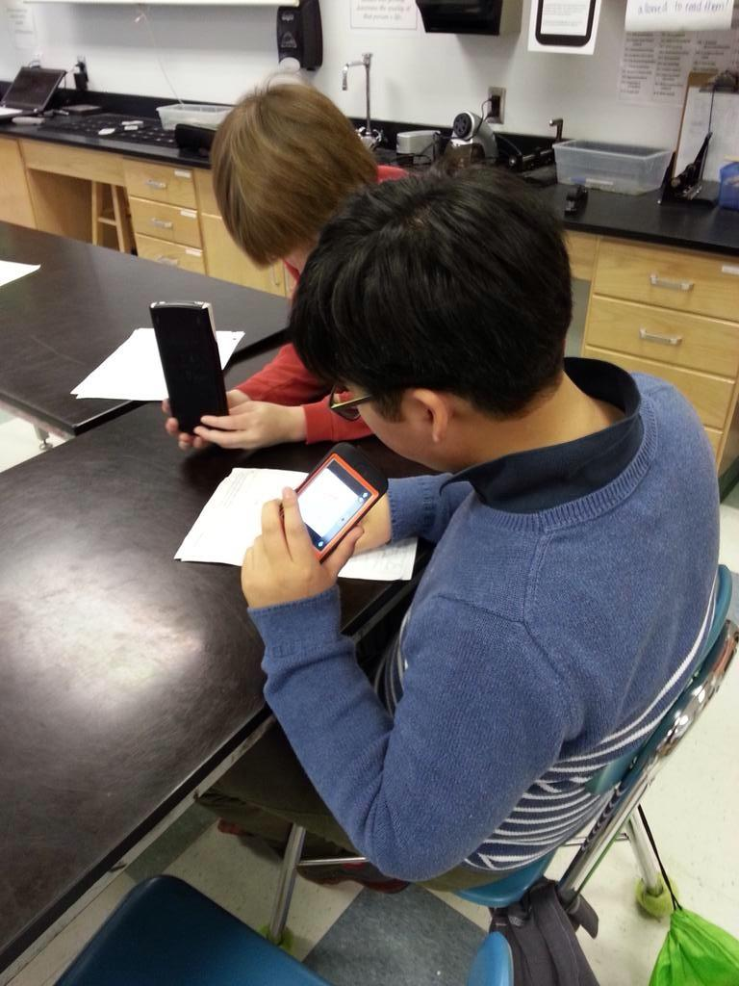
VoiceThread
Students build multimedia presentations.

Slide 10
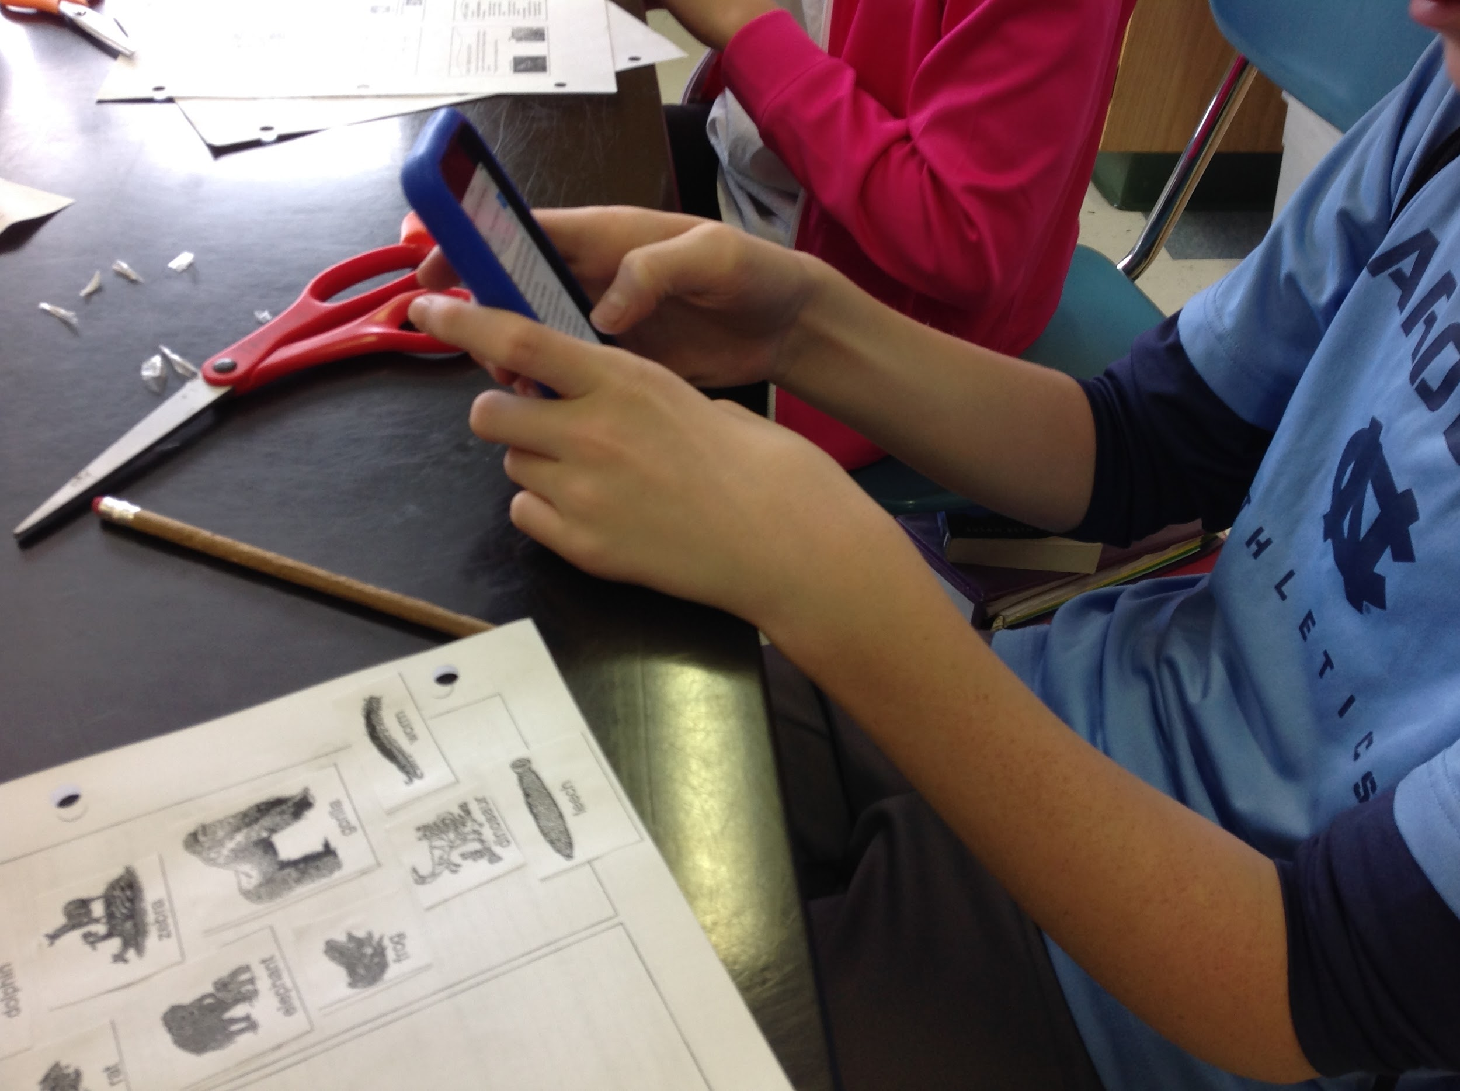
Research
Students identify and organize types of organisms.

